Slide 1
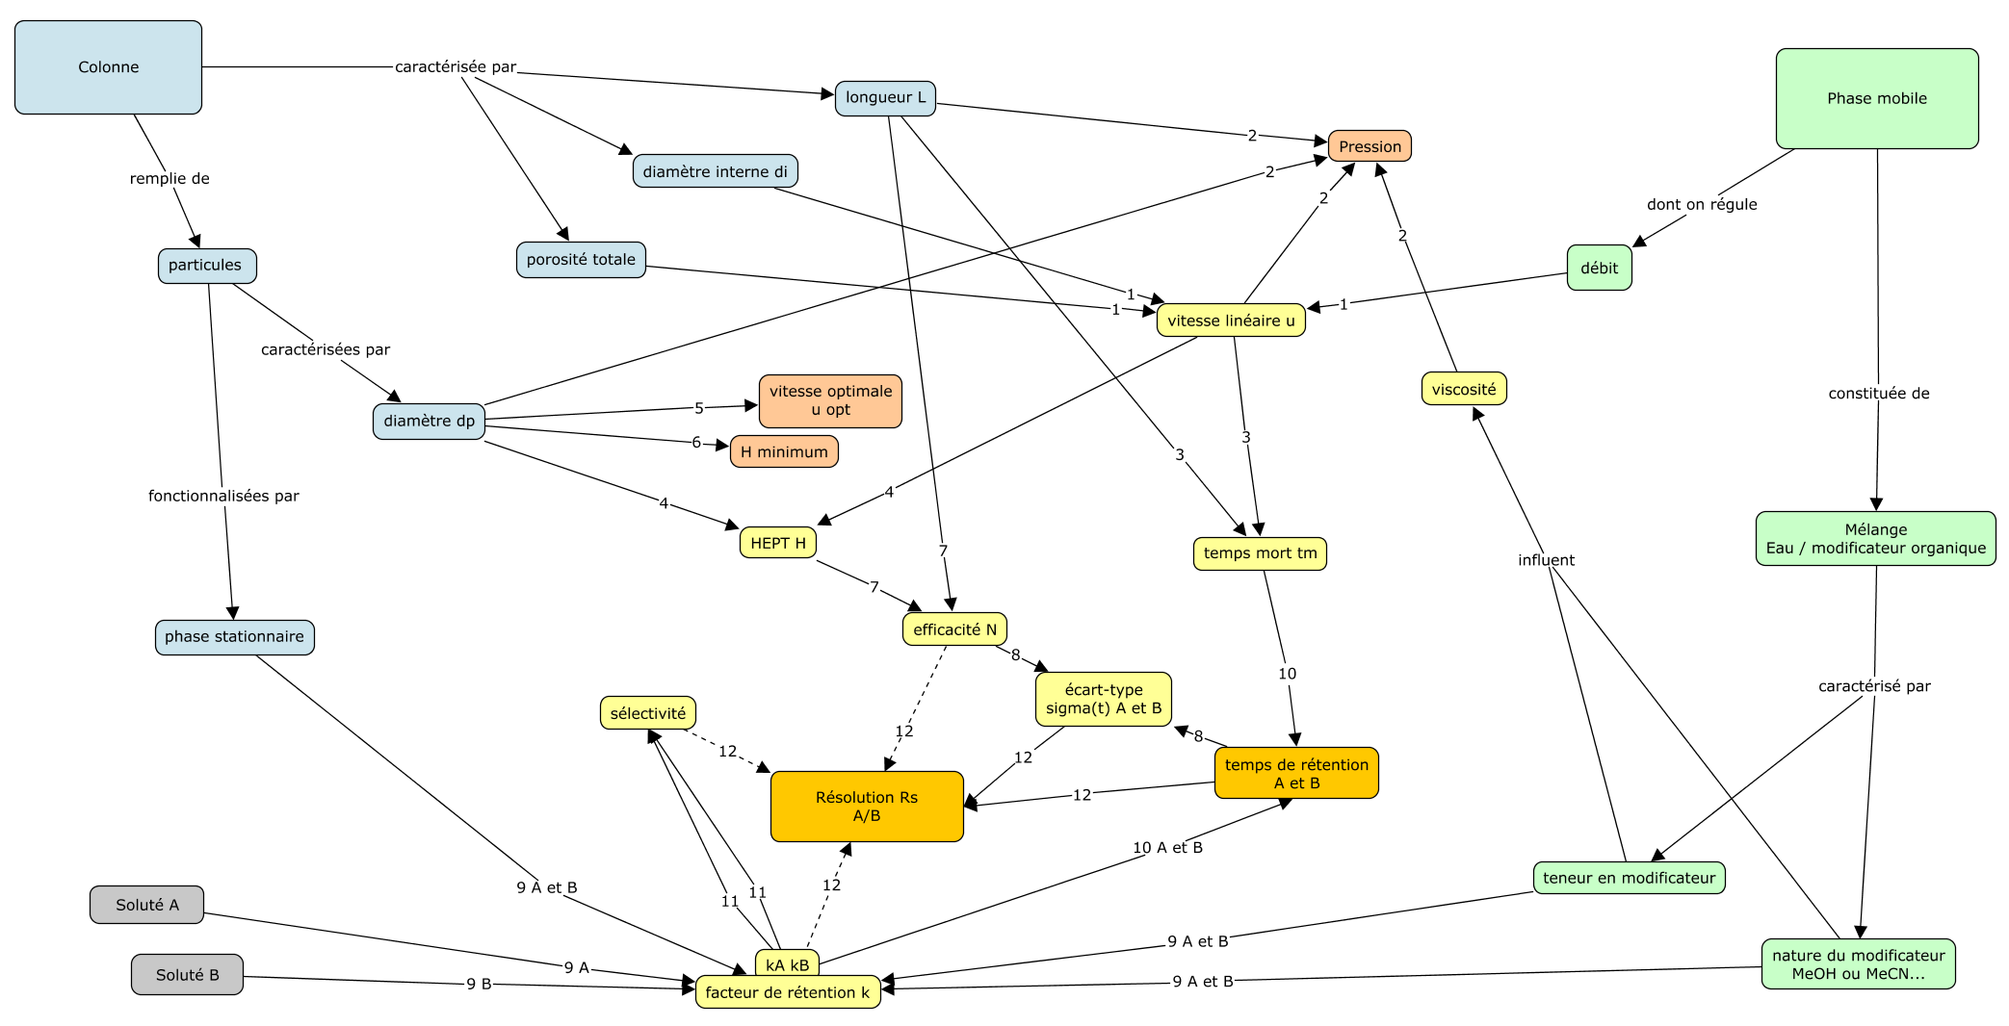
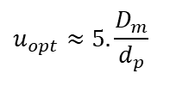

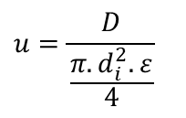
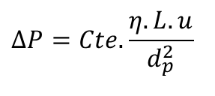
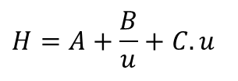
$$u_{opt}≈5.\frac{D_{m}}{d_{p}}$$
$$H_{min}≈3.d_{p}$$
$$ΔP=Cte.\frac{η.L.u}{d_{p}^{2}}$$
5
6
2
$$D_{m}≈10.10^{−6}cm^{2}/s$$
$$H=\frac{σ_{\left(L\right)}^{2}}{L}=\frac{σ_{\left(L\right)}^{2}}{L^{2}}.L=\frac{\frac{σ_{\left(L\right)}^{2}}{u^{2}}}{\frac{L^{2}}{u^{2}}}.L=\frac{σ_{\left(t\right)}^{2}}{t_{r}^{2}}.L$$
$$⇒σ_{\left(t\right)}^{2}={\frac{H}{L}t}_{r}^{2}$$
$$σ_{\left(t\right)}^{2}=σ_{\left(t\right)}^{2}.\frac{u^{2}}{u^{2}}=σ_{\left(L\right)}^{2}.\frac{1}{u^{2}}.\frac{L^{2}}{L^{2}}=\frac{σ_{\left(L\right)}^{2}}{L}.\frac{1}{L}\frac{L^{2}}{u^{2}}=\frac{H}{L}t_{r}^{2}…$$
$$u=\frac{D}{\frac{π.d_{i}^{2}.ε}{4}}$$
1
$$t_{m}=\frac{L}{u}$$
3
$$H=A+\frac{B}{u}+C.u$$
4
$$\ln\left(k_{ij}\right)=\ln\left(k_{w,ij}\right)−S_{ij}.φ_{modif,j}$$
$$avec C=f\left(d_{p}^{2}\right)$$
10_{A et B}
$$t_{r,i}=t_{m}(1+k_{i})$$
$$N=\frac{L}{H}$$
7
$$\ln\left(k_{i}\right)=\ln\left(k_{w,i}\right)−S_{i}.φ_{modif}$$
$$σ_{\left(t\right),i}=\frac{t_{r,i}}{\sqrt{N}}$$
9_{A et B}
$$Rs=\frac{t_{r,2}−t_{r,1}}{2.\left(σ_{1}+σ_{2}\right)}=\frac{\sqrt{N}}{4}\frac{α−1}{α}\frac{k_{2}}{1+k_{2}}$$
8
11
$$α=\frac{k_{2}}{k_{1}}$$
12
Notes:
2,5,6 : relations informatives, de positionnement

