Slide 1
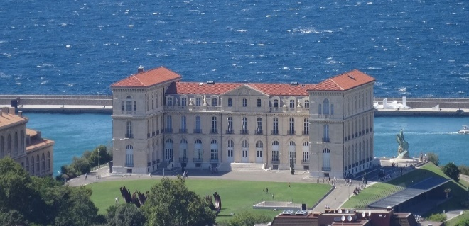
Marseilles, September 5-8, 2023
Topics
Instrumentation, Ion Chemistry
Ion Mobility, Imaging
Biomolecules, Complex Mixtures
Forensics, Omics
Natural Products, Polymers…
Plenary Speakers
Maria Elisa CRESTONI
University of Rome « La Sapienza »
François FENAILLE
CEA Saclay
Ron HEEREN
University of Maastricht
Martin LARSEN
University of Southern Denmark
Ryan RODGERS
Florida State University
Hélène ROGNIAUX
INRAE – Nantes
Jana ROITHOVA
University of Radboud
Emmanuelle SACHON
University of Sorbonne
Palais du Pharo
Key Dates
February 6, 2023 – Opening of abstracts submission and registration
May 28, 2023 – End of oral communications submission
July 30, 2023 – End of early bird registration
Scientific committee
Carlos Afonso – Univ. Rouen
Christine Enjalbal – Univ. Montpellier
Luke MacAleese – Univ. Lyon 1
Alain MUSELLI – Univ. Corse
Laurent DEBRAWER – INRAE Toulouse
Aura TINTARU – Univ. Aix-Marseille
Joëlle VINH – ESPCI Paris
Organizing committee
Gaëlle HISLER
Valérie MONNIER
Aura TINTARU
Laurent DEBRAUWER
https://jfsm2023.sciencesconf.org/

Slide 2
Plenary Speakers
Maria Elisa CRESTONI
University of Rome « La Sapienza »
François FENAILLE
CEA Saclay
Ron HEEREN
University of Maastricht
Martin LARSEN
University of Southern Denmark
Ryan RODGERS
Florida State University
Hélène ROGNIAUX
INRAE – Nantes
Jana ROITHOVA
University of Radboud
Emmanuelle SACHON
University of Sorbonne
Marseilles, September 5-8, 2023
Topics
Instrumentation, Ion Chemistry
Ion Mobility, Imaging
Biomolecules, Complex Mixtures
Forensics, Omics
Natural Products, Polymers…
Palais du Pharo
Key Dates
February 6, 2023 – Opening of abstracts submission and registration
May 28, 2023 – End of oral communications submission
July 30, 2023 – End of early bird registration
https://jfsm2023.sciencesconf.org/

Slide 3
Key Dates
February 6, 2023 – Opening of abstracts submission and registration
May 28, 2023 – End of oral communications submission
July 30, 2023 – End of early bird registration
Plenary Speakers
Maria Elisa CRESTONI
University of Rome « La Sapienza »
François FENAILLE
CEA Saclay
Ron HEEREN
University of Maastricht
Martin LARSEN
University of Southern Denmark
Ryan RODGERS
Florida State University
Hélène ROGNIAUX
INRAE – Nantes
Jana ROITHOVA
University of Radboud
Emmanuelle SACHON
University of Sorbonne
Palais du Pharo
https://jfsm2023.sciencesconf.org/

